Slide 1

CAPSTONE PROJECT PRESENTATION
(INTERNSHIP REPORT)
MENTOR: DEEPAK GUPTA
COMPANY: CADENCE DESIGN SYSTEMS
NAME: SPARSH CHADHA
E. NO: E18CSE179

Slide 2
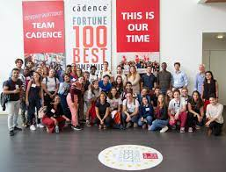

ABOUT THE ORGANIZATION
Cadence is a leader in electronics design with over 30 years of experience in computer software. The company applies the underlying intelligent system design strategy to provide software, hardware, and IP that enable the design concept.
Cadence's customers are the most innovative companies in the world, the most dynamic markets for consumers, hyperscale computing, 5G communications, automotive, aerospace, industry and healthcare, from chips to circuit boards to systems. We provide excellent electronic products for applications.
Fortune magazine has listed Cadence as one of the Top 100 Best Companies to Work For for the seventh consecutive year.

Slide 3
SOLUTIONS OFFERED
Semiconductor and systems companies that provide the most complete and integrated end-to-end solutions to help today's electronics designers optimize future products for the following purposes:
Silicon design, simulation, implementation and approval creation for analog and digital circuits. Standard design IP; IC packaging including EDA tools with enhanced machine learning and EDA flow with machine learning.
Advanced packaging, secure embedded software, and PCB system design. Analysis of electromagnetic and electrothermal effects of semiconductors, housings, boards and systems. Co-optimization with semiconductor components.
Intelligence IP for designing inference processing on edge devices.

Slide 4
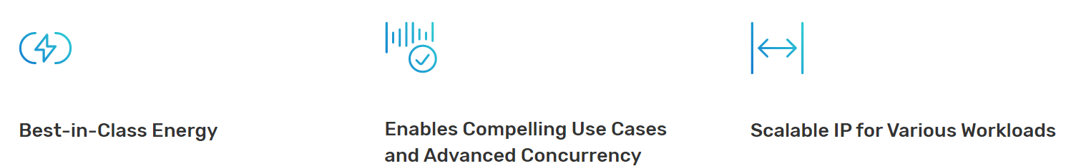
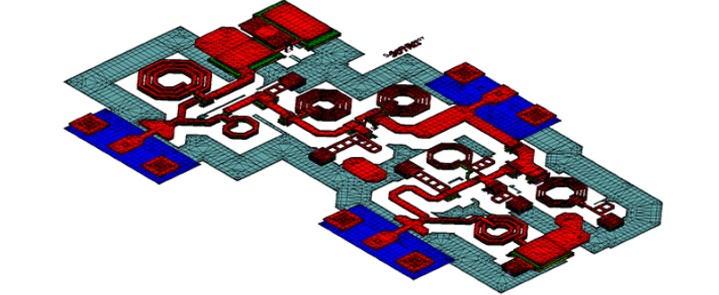
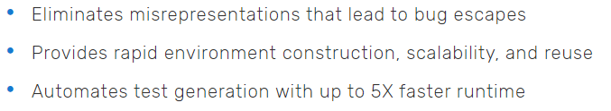
SOME CADENCE PRODUCTS
AI BOOST NNE 110
EMX PLANAR 3D SOLVER
CADENCE SPECMAN ELITE

Slide 5
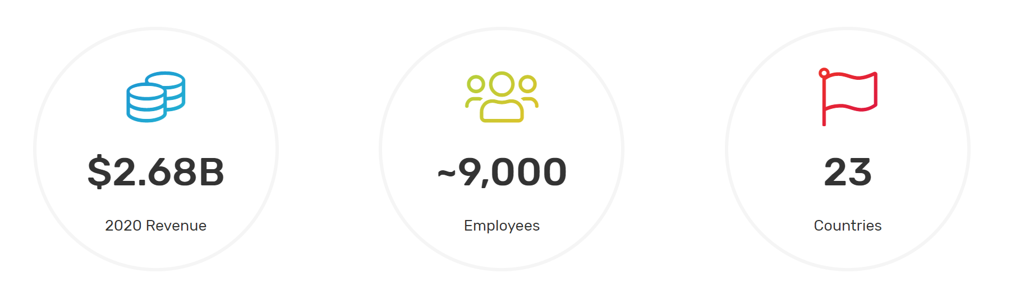
CADENCE FACTS

Slide 6

WHERE I WAS AT CADENCE
I was hired as a Software Developer Intern at Cadence
I was part of Licensing, Installation and Release Operations (LIRO) Team at Cadence Design Systems.
Team Charter: Enable Cadence products by providing technology and tools to deliver secure license key enabled products to end users.
Provide technology and tools to support
Fulfillment and License Compliance.​

Slide 7
LIRO TEAM STRUCTURE
Sashi Subramanian
(Sr Software Engineering Group Director)
Rostislav Stelmach - Dev
(Dublin))
Deepak Gupta
(Sr Software Engineer in Test Manager)
Chris Guckian - Dev
(Dublin)
Sparsh Chadha
(SDE Intern)
Taruna Gakhar
(Lead Software Engineer)
Anuj Shukla
(Lead Software Engineer)
Ankit Bansal
(Lead Software Engineer)

Slide 8
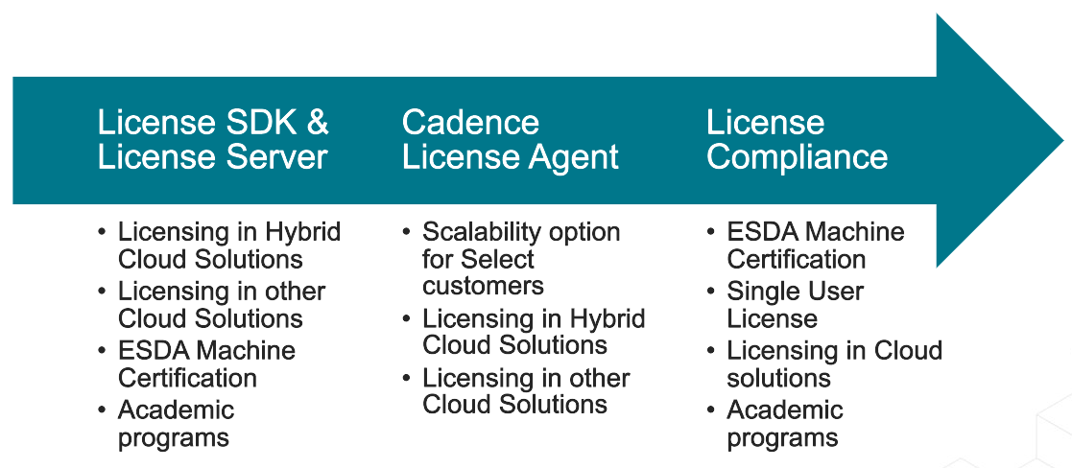
LIRO CORE FUNCTIONS

Slide 9
INTERNSHIP PROJECTS
Cadence products are licensed using Flexera’s FlexNet technology and are protected using proprietary and third-party technologies
Cadence Agent
This homegrown solution allows Cadence customers to scale their license server to many orders of magnitude than the Flexera server
IPv6 support for Licensing and License Compliance
Enhance Cadence Licensing and License Compliance ecosystem to support IPv6
Daily Regressions and Sanity testing
Note: Can’t reveal in depth information about projects due to NDA policy.

Slide 10





TECHNOLOGIES & FRAMEWORKS USED
MobaXterm

Slide 11
LEARNING OUTCOMES
Truly understood the meaning of Testing and Automation. For a very long time I felt that Testing was almost all about manually finding out errors. But after the internship my perception towards Quality and Assurance changed drastically.
Importance of Agile Methodology in a corporate world.
Developed work habits and attitudes necessary for succeeding in a corporate world.
Developed communication, interpersonal and other critical skills. Daily standups helped me a lot in achieving these skills.
The corporate world is totally different from the university world.

Slide 12
THANK YOU
SPARSH CHADHA
E18CSE179

